Slide 1
Scope of Human geogaphy
Each of physical, Biological and social science has its own philosophy, methodology and scope. Likewise Human geography covers a wide field and its scope is enormous.
The core of the subject matter embraces the study of the relationship between man and environment and the pattern of socio-cultural lifestyles in different regions reflects this relationship.

Slide 2
Human geography covers the study of Human race, the growth, distribution and density of population and their demographic attributes
It takes into account the types and pattern of human settlement
It also includes the study of primary, secondary ,tertiary activities, modes of transportation and communication, human health and health care system within its scope.

Slide 3
Views of Prof. E.Huntington on scope of Human geography:
Huntington divided the whole scope of into two divisions- i) physical conditions : It includes location of place, climate, landforms, water bodies, soil and minerals, plants and animals
ii) Human responses refers to how the people of different physical conditions make adjustment to it and lead their lifestyles. That is why so many different type of primary occupations are visible on the earth.

Slide 4
Prof. Roxby divided the scope of Human geography into four dividsions in 1930s-
i) Racial geography ii) political geography iii) social geography and iv) economic geography
Subsequently several branches have evolved and the human geography has widened to become an omnibus term. The broad subfields of Human geography as under its scope are- Cultural, Economic, Social, Behavioural , Political, Urban and Population Geography

Slide 5
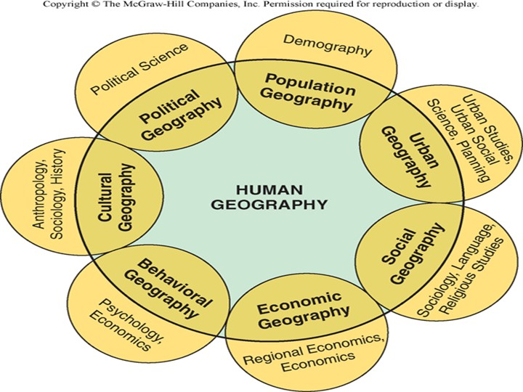
Subfields of Human geography in its scope and its related social sciences

Slide 6
In parallel with geography as a whole,Human geography is made up of three closely linked components-
i) the spatial analysis- it is related to human population, its the number and characteristics as spread over the earth surface.

Slide 7
ii) the ecological analysis- it is concerned with the relation between the human population and its environment.
Iii) the regional synthesis- It combines the first two themes in different regions of the earth surface.
All these three themes are pursued at various spatial scales- from macro(country or continent level) to micro levels(village level).

Slide 8
Human geography's content provides an integration for all the social sciences because it gives those social sciences the spatial and system viewpoints. Therefor, at present human geography has assumed an interdisciplinary nature. Such nature of human geography has made the subject more applied and significant for solution of various problems of societies.

Slide 9
Currently it is going through exciting period in its development. As new socio economic problems are identified and new methods of analysis are formulated. Its model and theories have allowed us to better comprehend the realities of socio political system of the societies.

Slide 10
The scope of Human geography is very dynamic in nature. Because with the passing of time the relationship between man and environment is getting more complex than earlier due to changing human needs and aspirations. At the same time such dynamic nature of the subject has widened its scope over time.

